Slide 1
Artifact Defense
何基正 Daniel He

Slide 2
Daniel He Artifact Defense
June 29th 2020

Slide 3
Moonshot Defense
Jizheng (Daniel) He
June 28th, 2021

Slide 4
Contents
My Growth in MSA
Artifact: Analytical Essay
Artifact: Research Paper
Plans in College

Slide 5
Computer Science

Slide 6
Software Engineering
Computer Graphics
Computer Vision
Reverse Engineering
Computer Network
Artificial Intelligence
Internet of Things
Algorithms & Data Structures
Digital & Analog Circuit
C, C++, Python, Java, Dart, Matlab, Racket, HTML, CSS, JavaScript, SQL, Bash, PowerShell, C#, x86 Assembly
Computer Science, Academically
Frontend Libraries: Vue.js, Flutter.js, Echarts, IviewUI, Bootstrap, JQuery, Three.js, P5.js/Processing.js
Backend Structures: Springboot, Flask, Django, Node.js
Other libraries: Chipmunk, SFML, OpenCV, Qt, Arduino

Slide 7
~90 Workshops
HTML+CSS+JS
C++ Arduino
Reverse Engineering
Vue.js
3D Modelling
Carpentry
Dashboard
School Information Platform
Defense Grading Panel
MTC Transcript Visualization
Academic => Community
Matrix
Makerspace
Build Nights
Solar Panel Project
Daily Maintenance & Constant Support

Slide 8
Teaching Assistant for CS courses and CS related IP Courses
Course Map @ MSA
Community
Artemis
Most influential club 2020
Currently the biggest club in MSA
Frisbee Courses

Slide 9
Firm in my choices
Choice Making & Responsibilities
Changes/Δ
Self-Reflection
Face Challenges

Slide 10
Artifact: Analytical Essay
French & American Revolutions

Slide 11
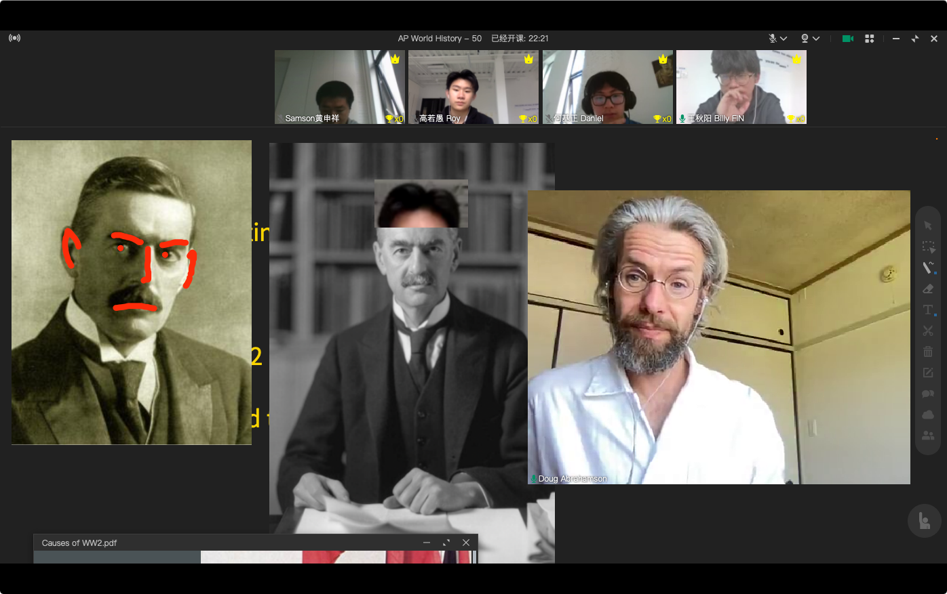
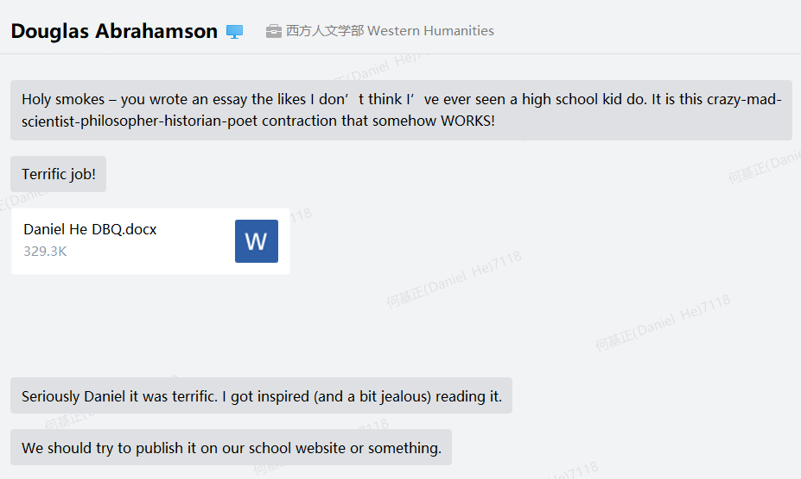

Slide 12
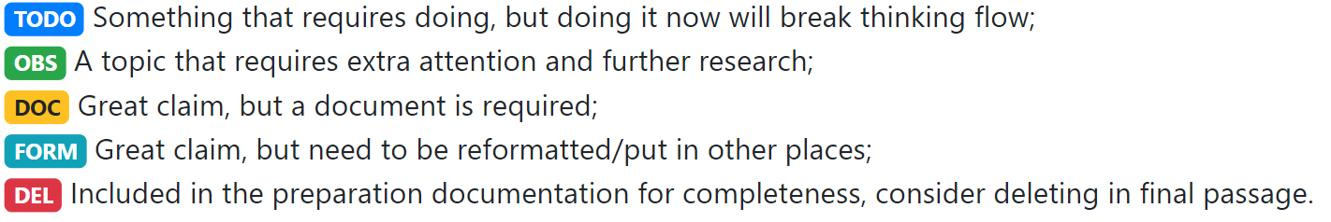
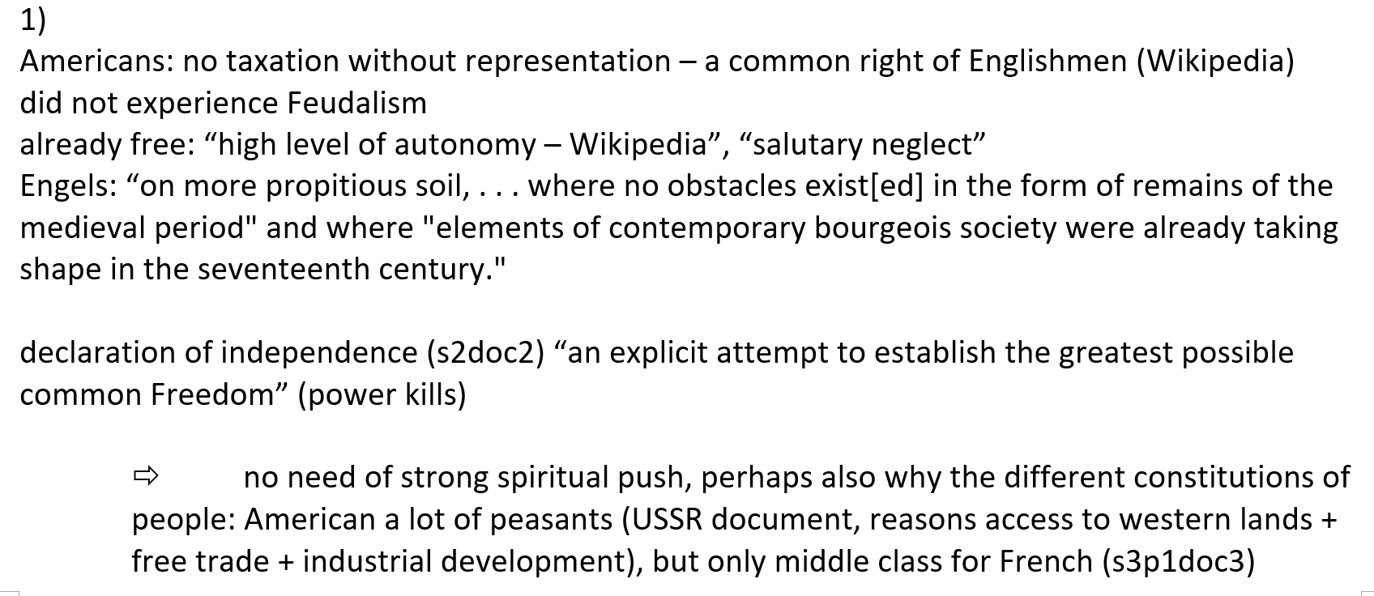
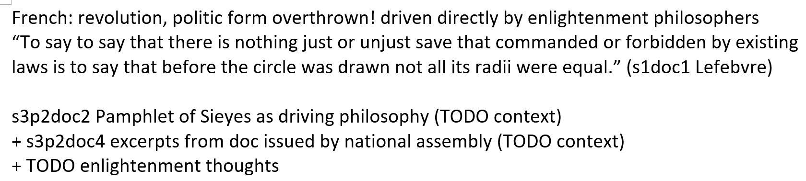

Slide 13
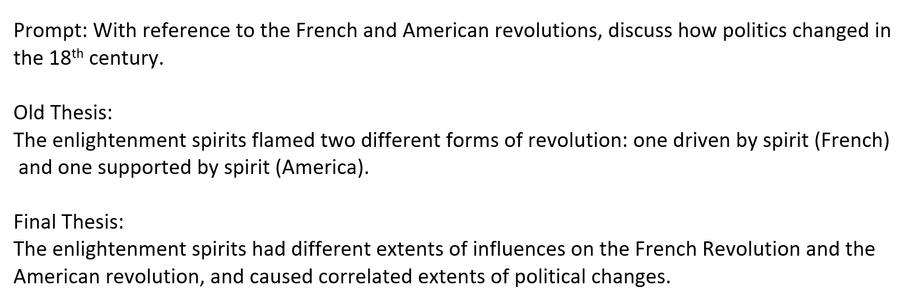
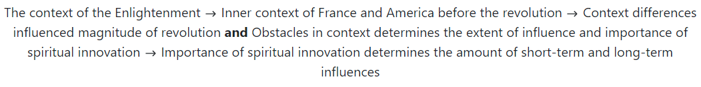

Slide 14
Artifact: Research Paper
3D Sketching

Slide 15
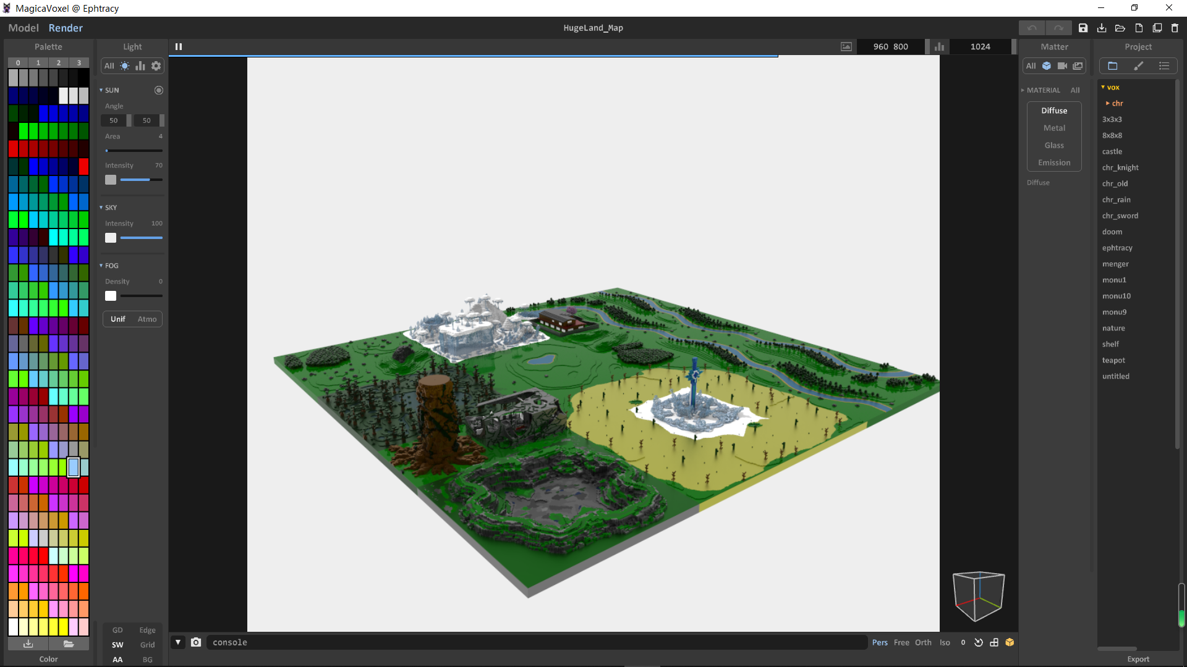

Slide 16
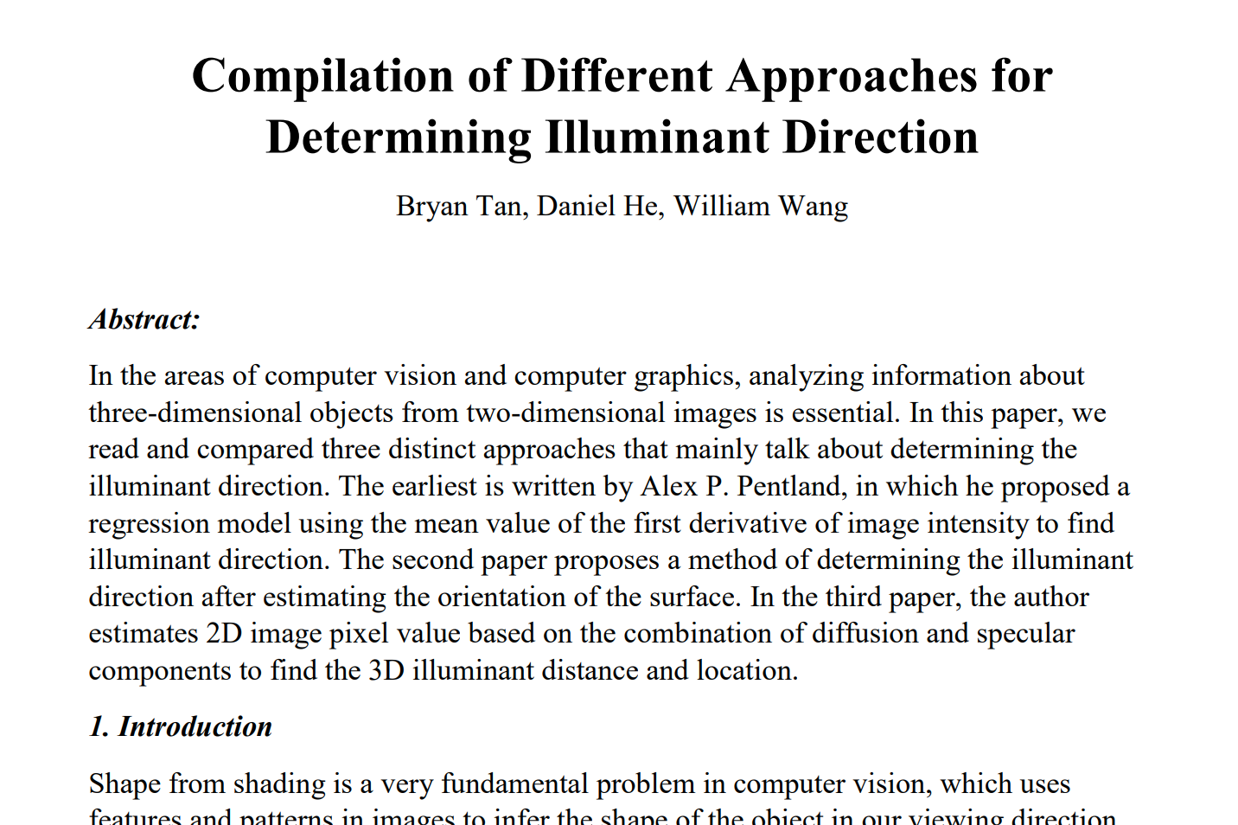
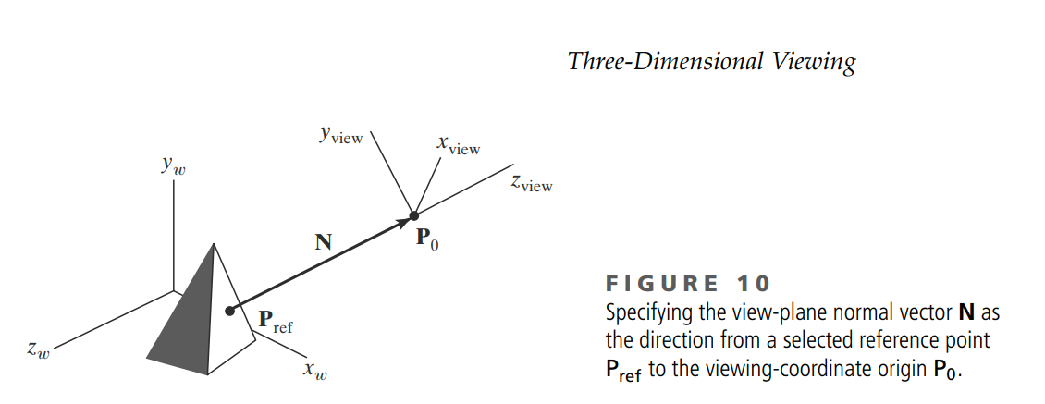

Slide 17
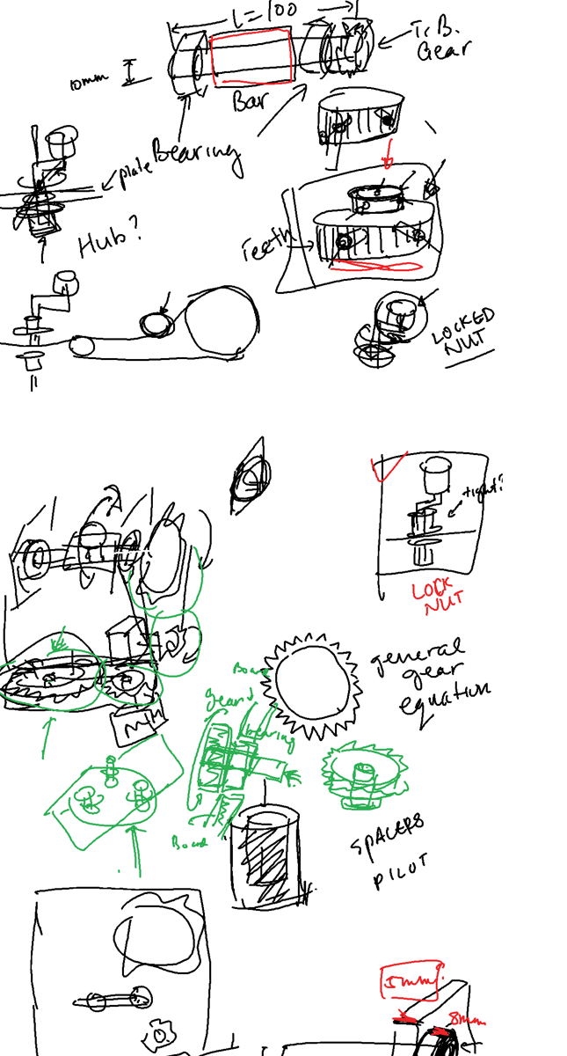
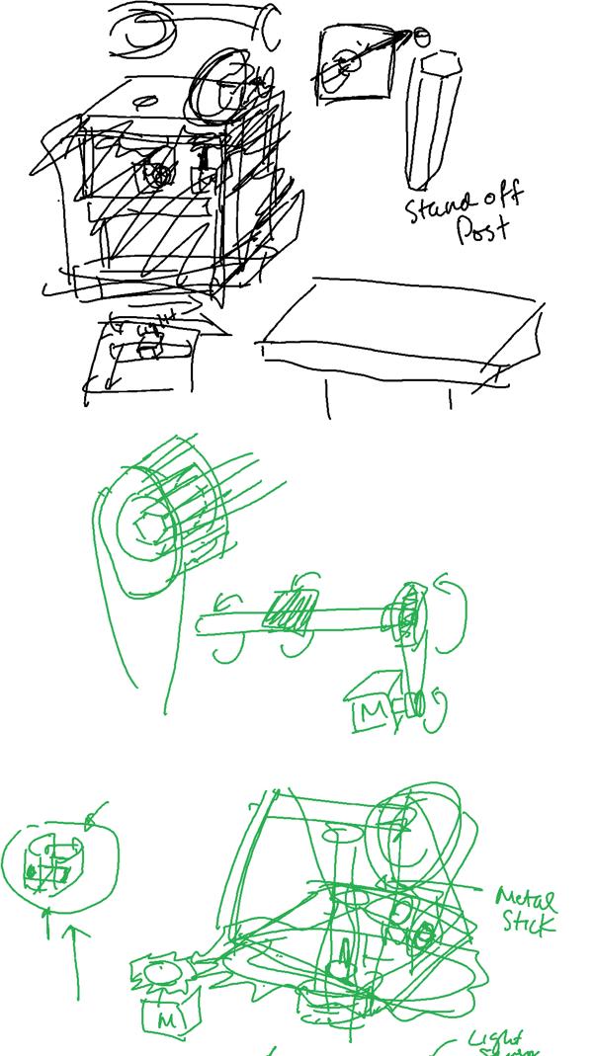
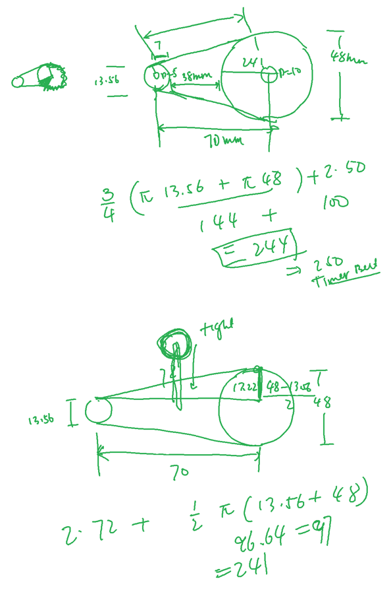

Slide 18
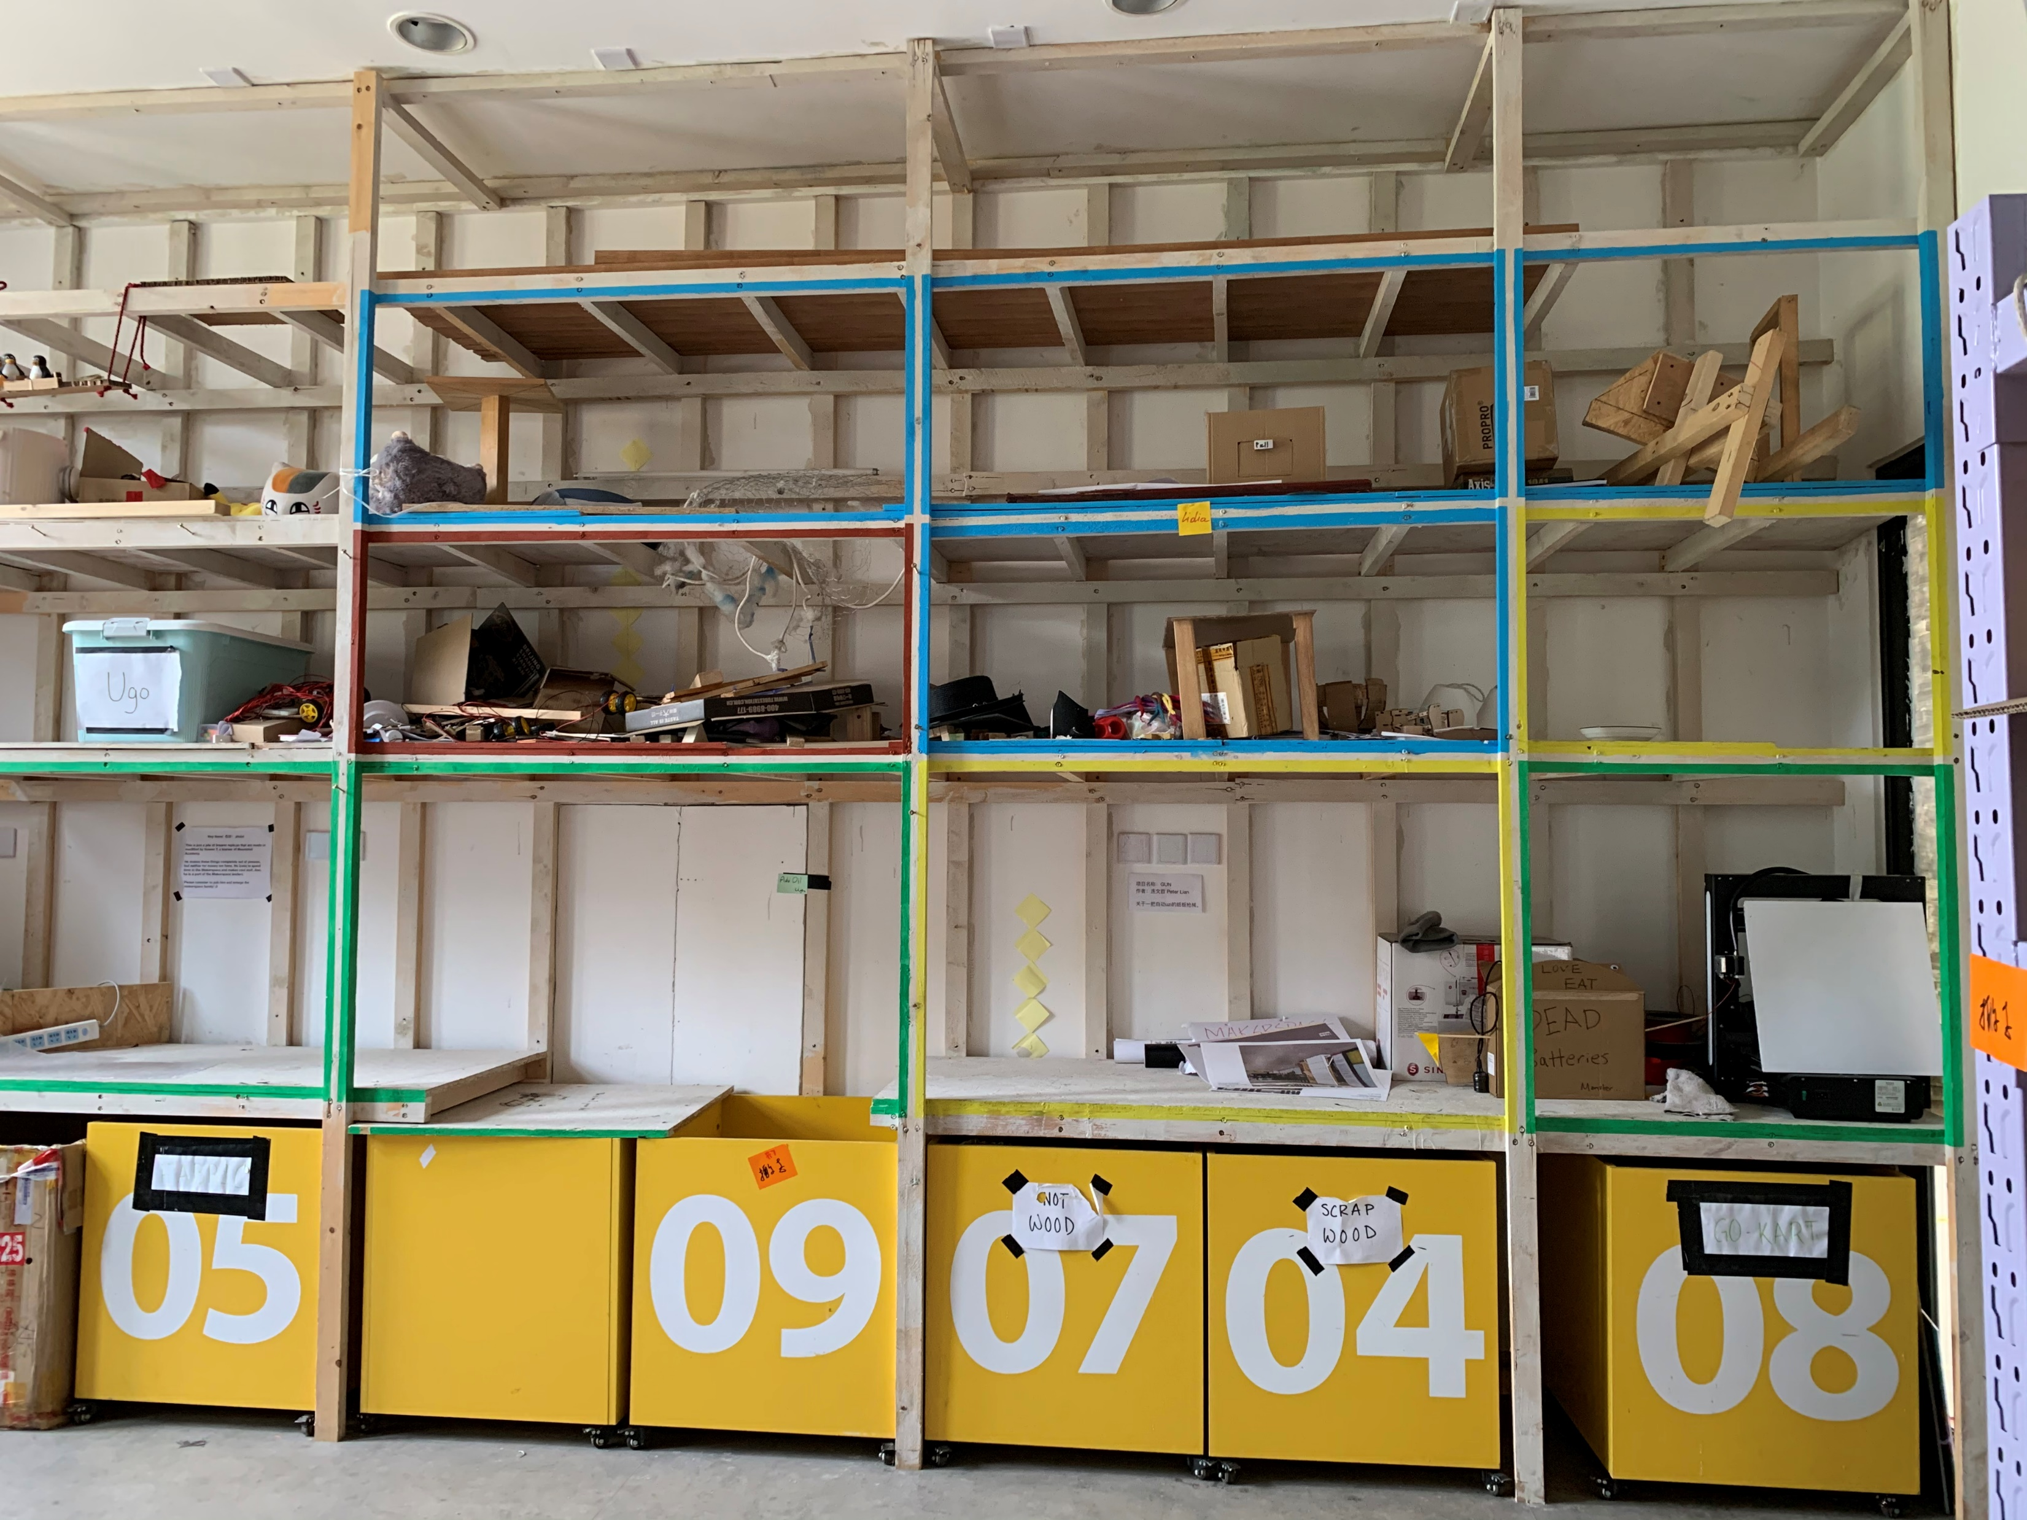
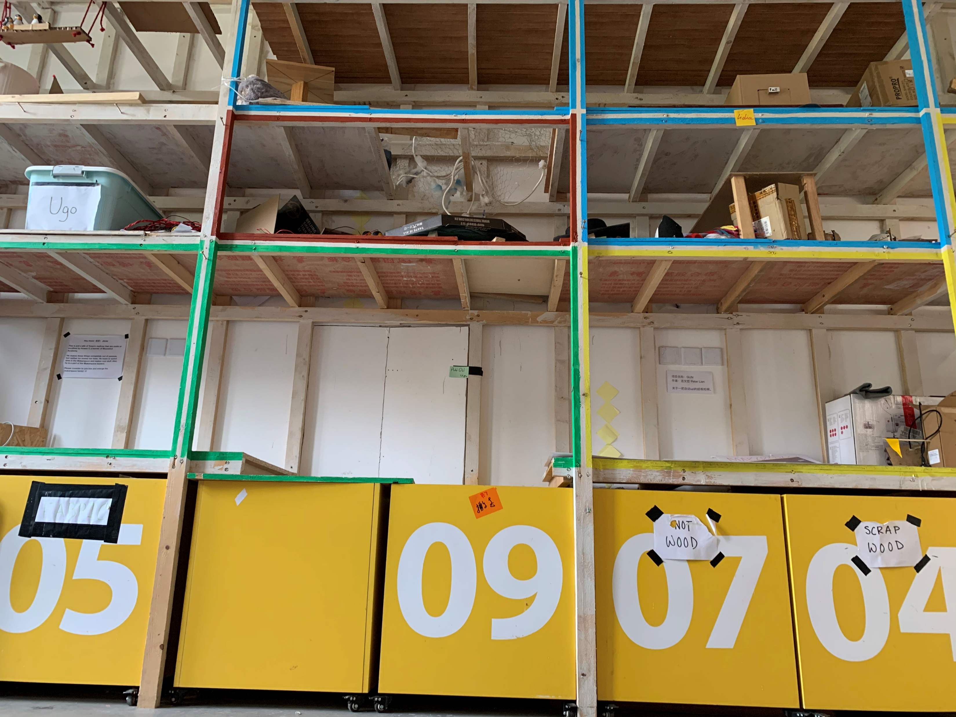
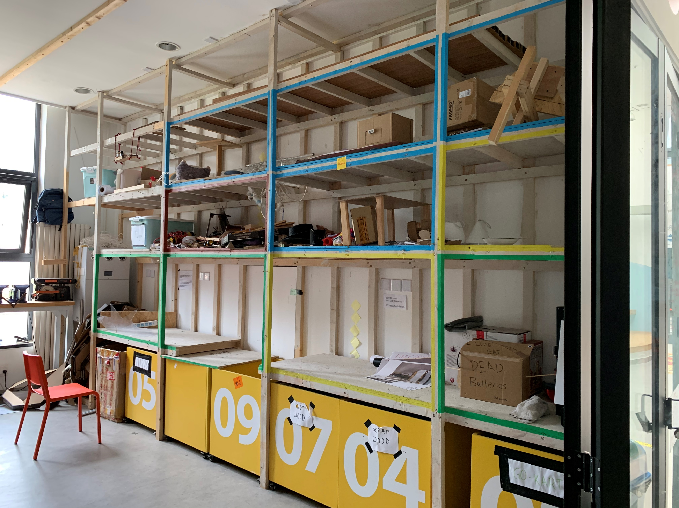
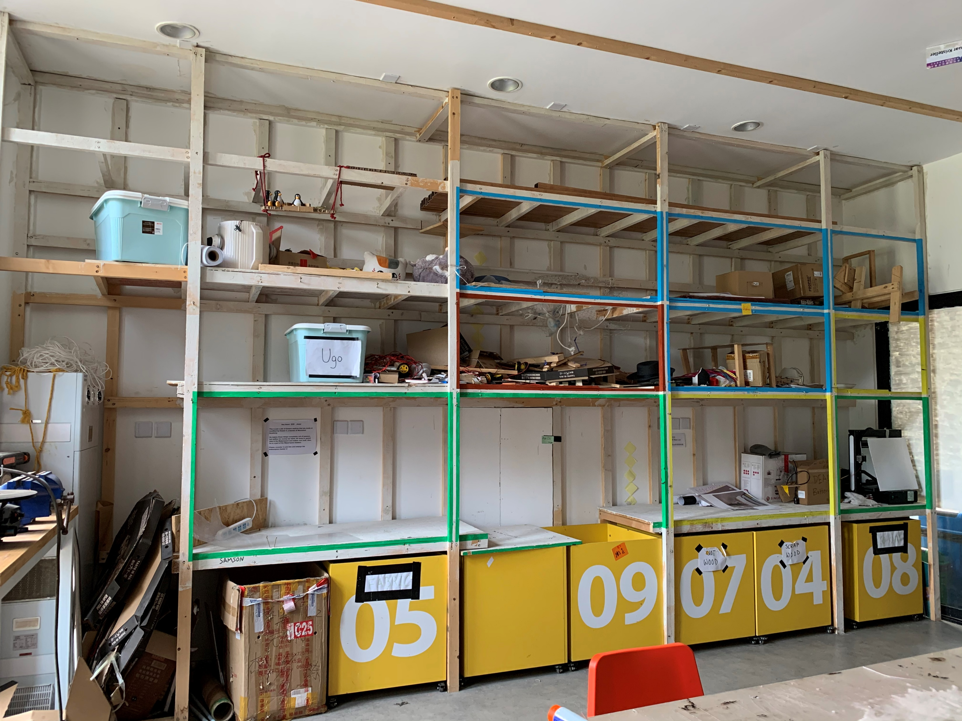
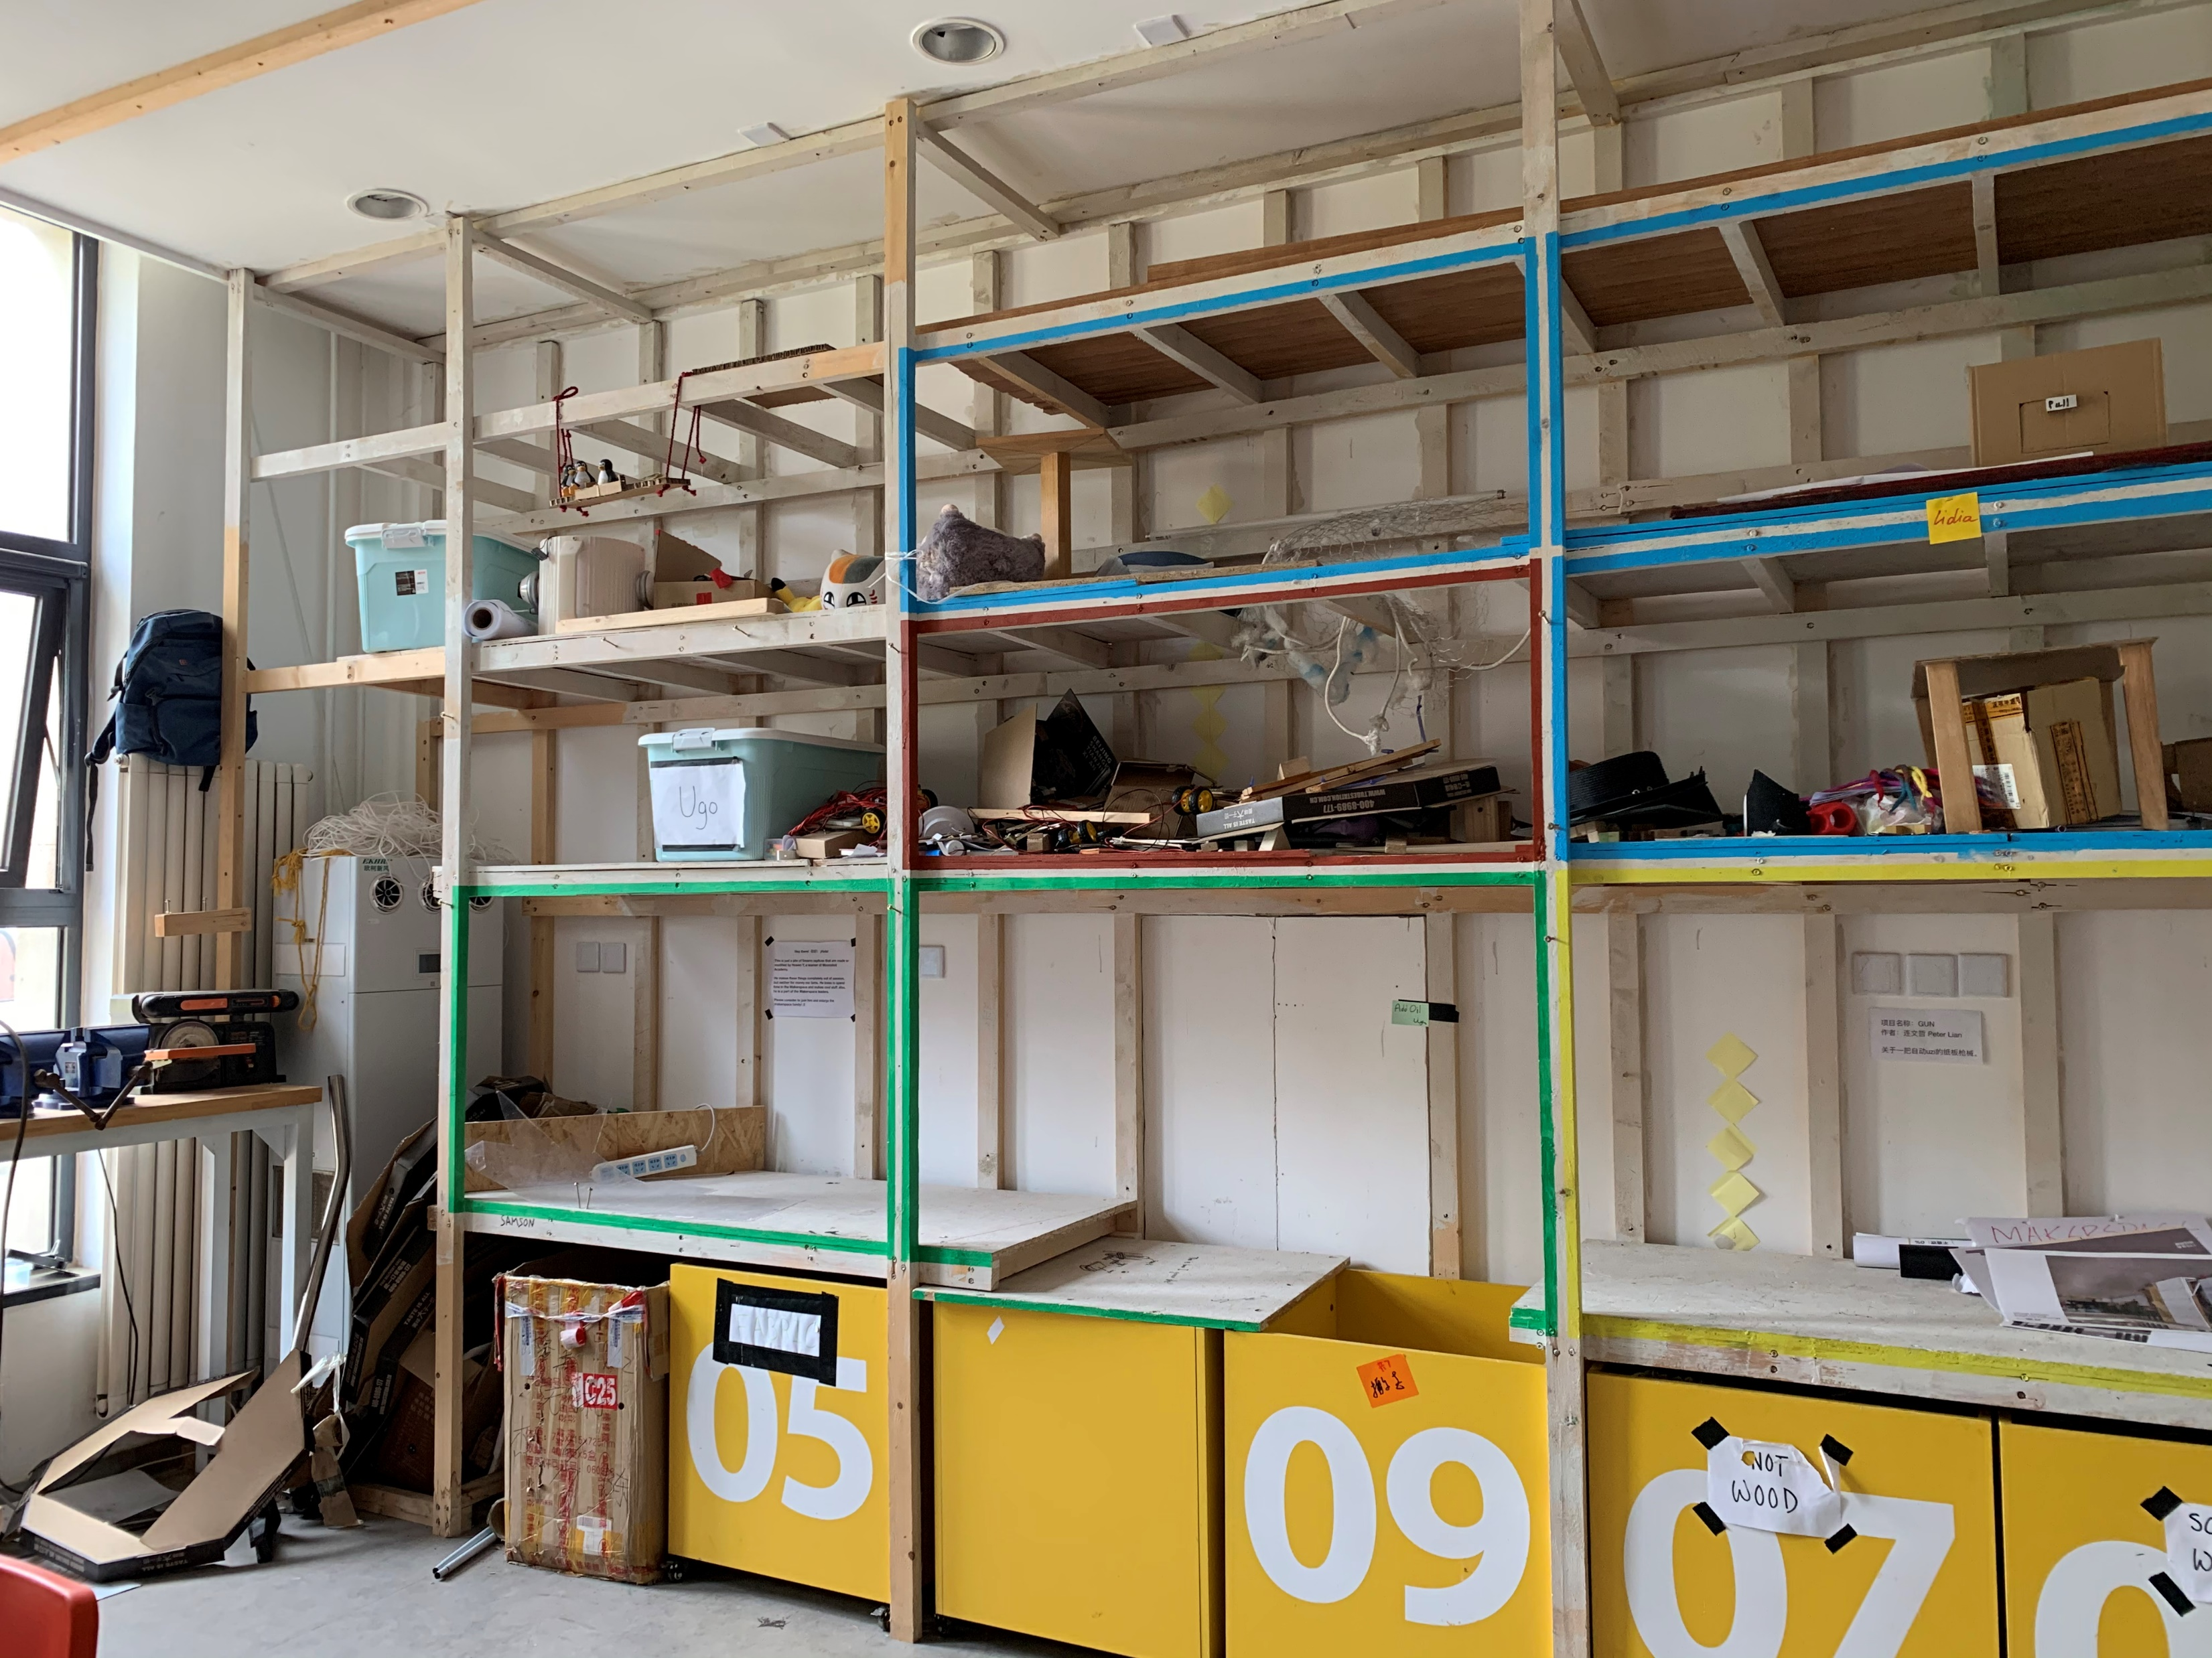

Slide 19
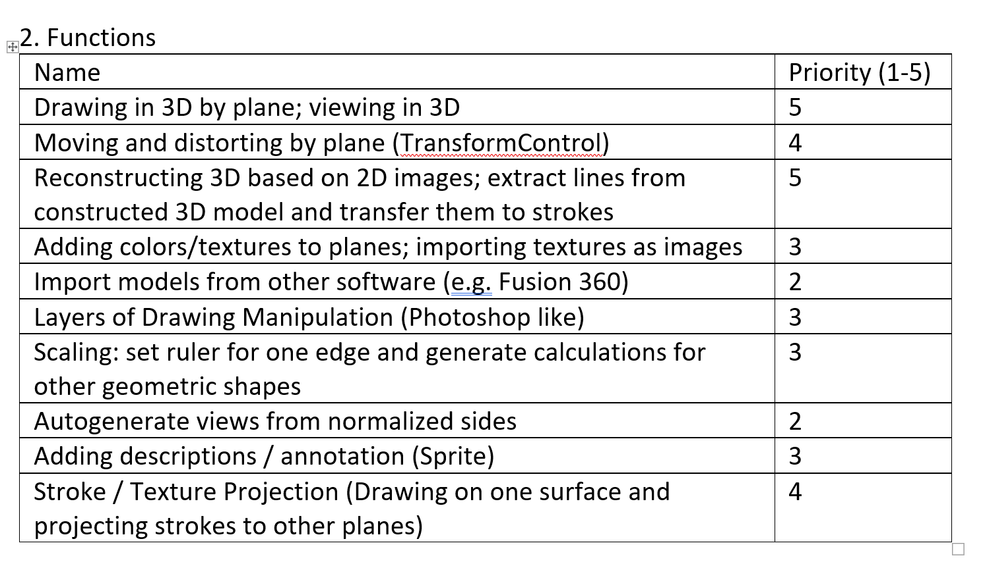

Slide 20
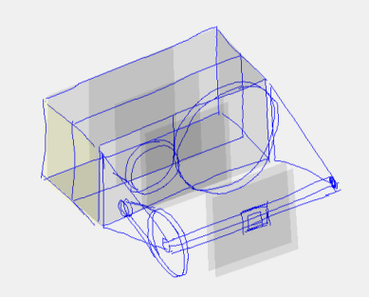
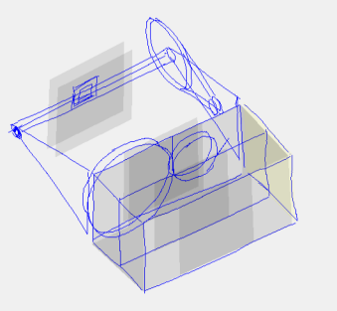
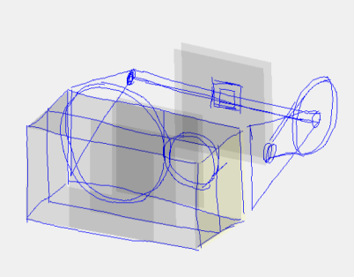
Tech Stack
Frontend: Vue.js + Three.js
Backend: Flask + OpenCV

Slide 21
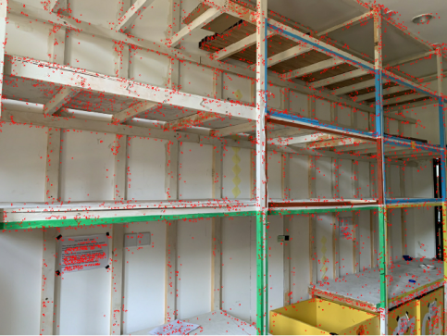
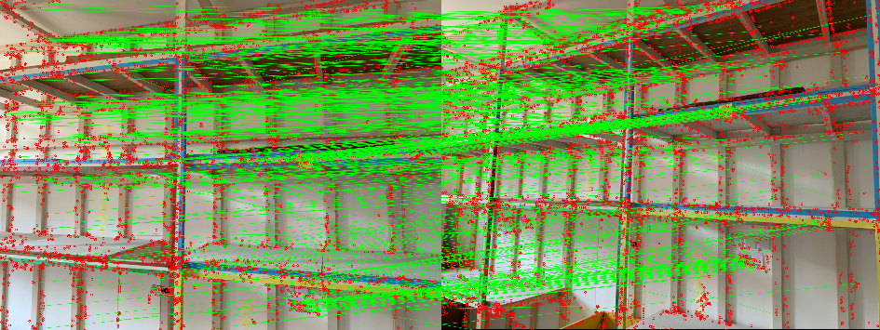

Slide 22
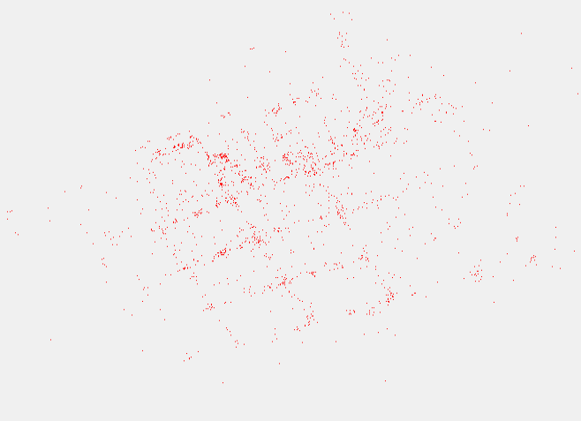
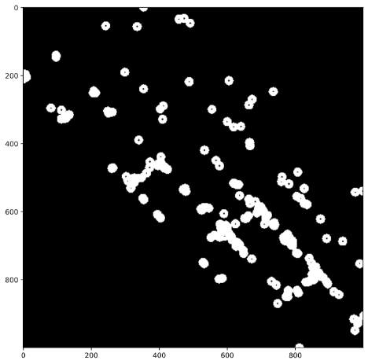
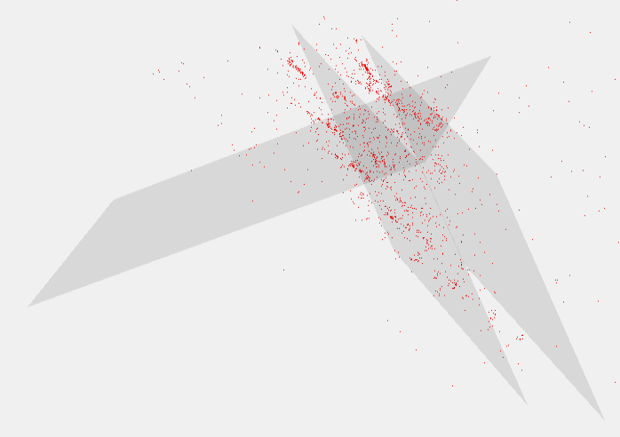
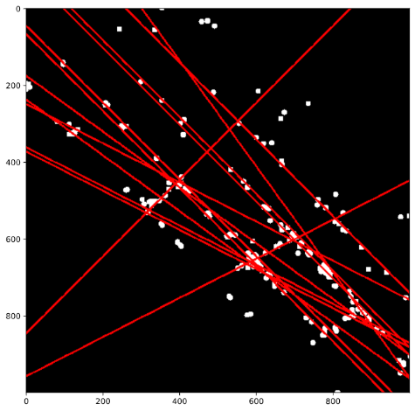

Slide 23
My College Plan

Slide 24


Slide 25
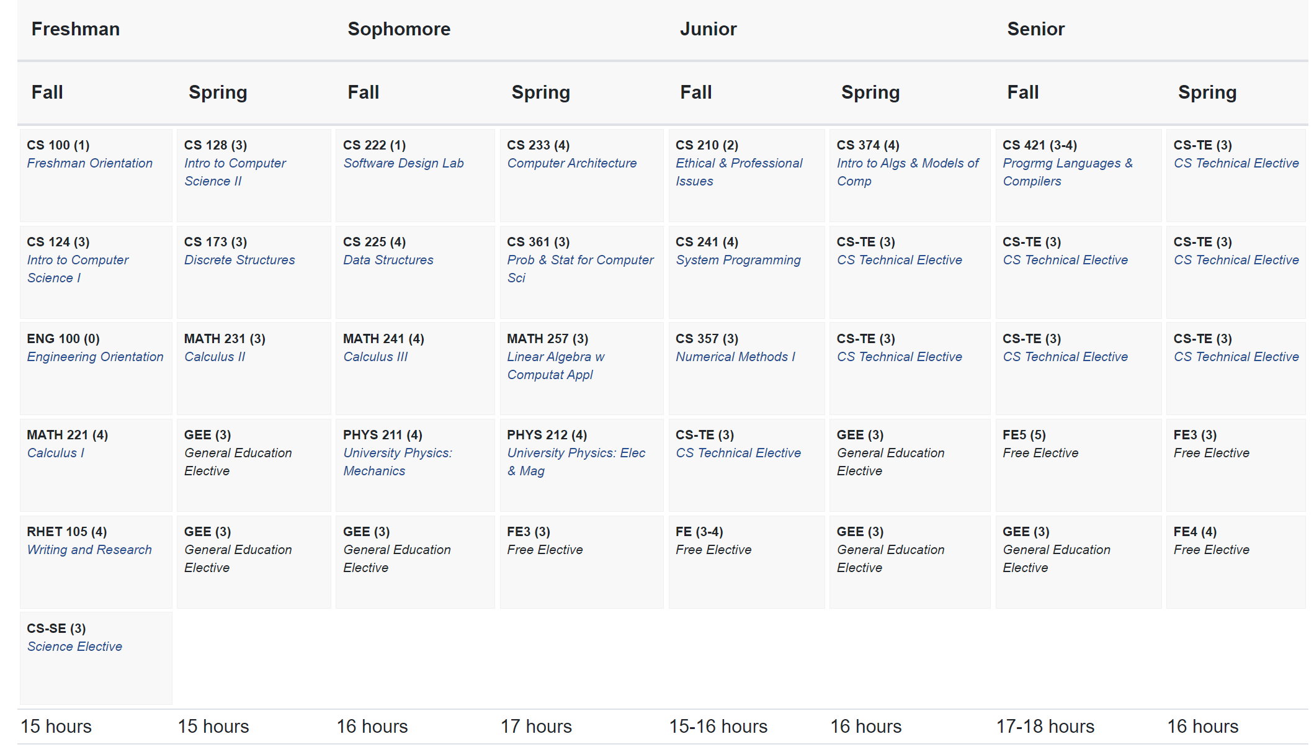

Slide 26
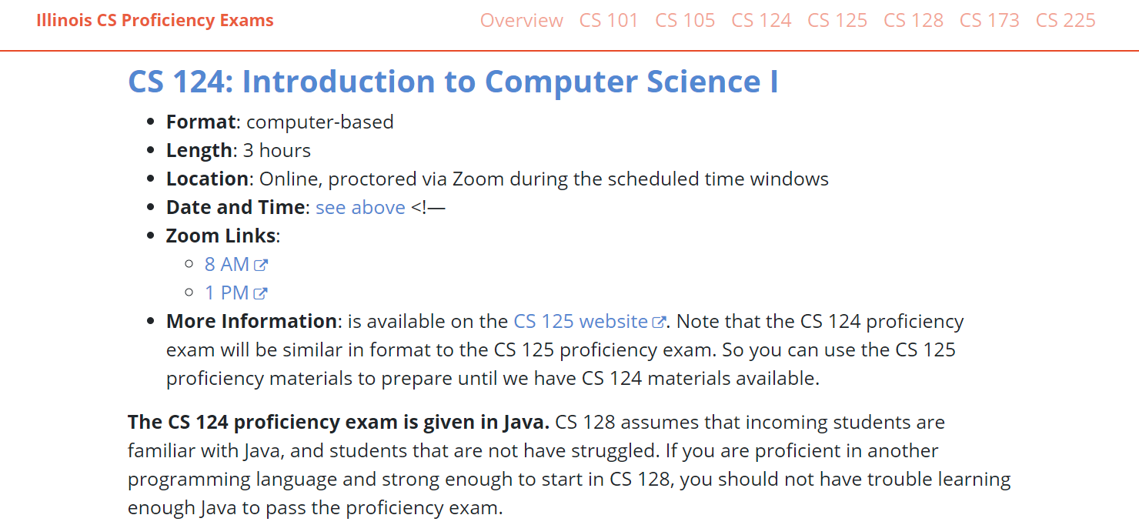

Slide 27
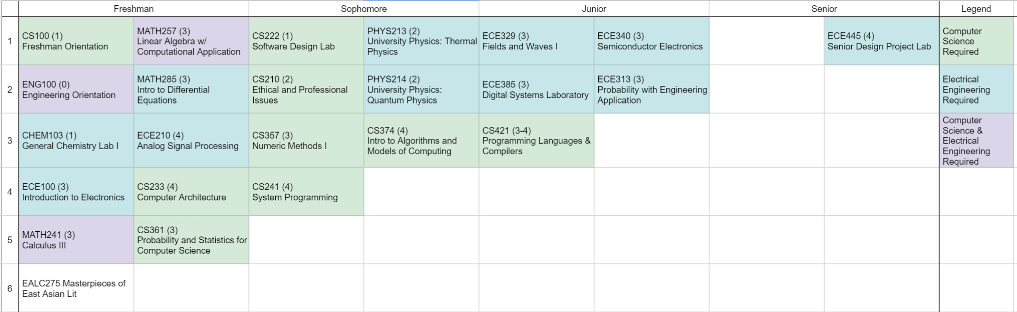

Slide 28
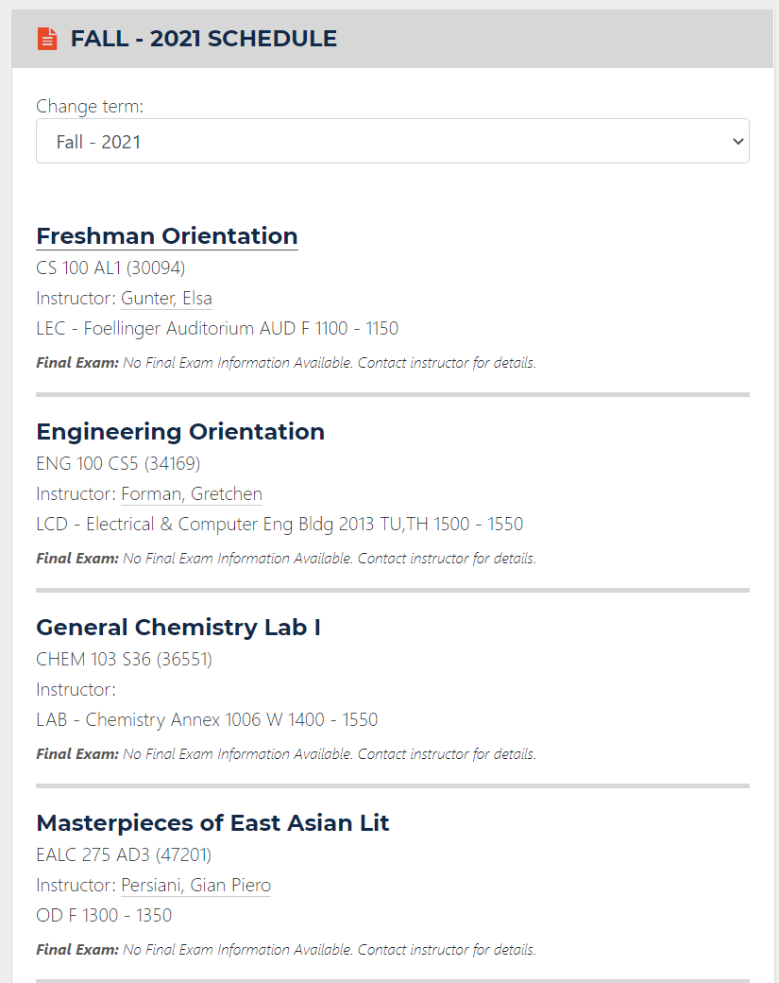
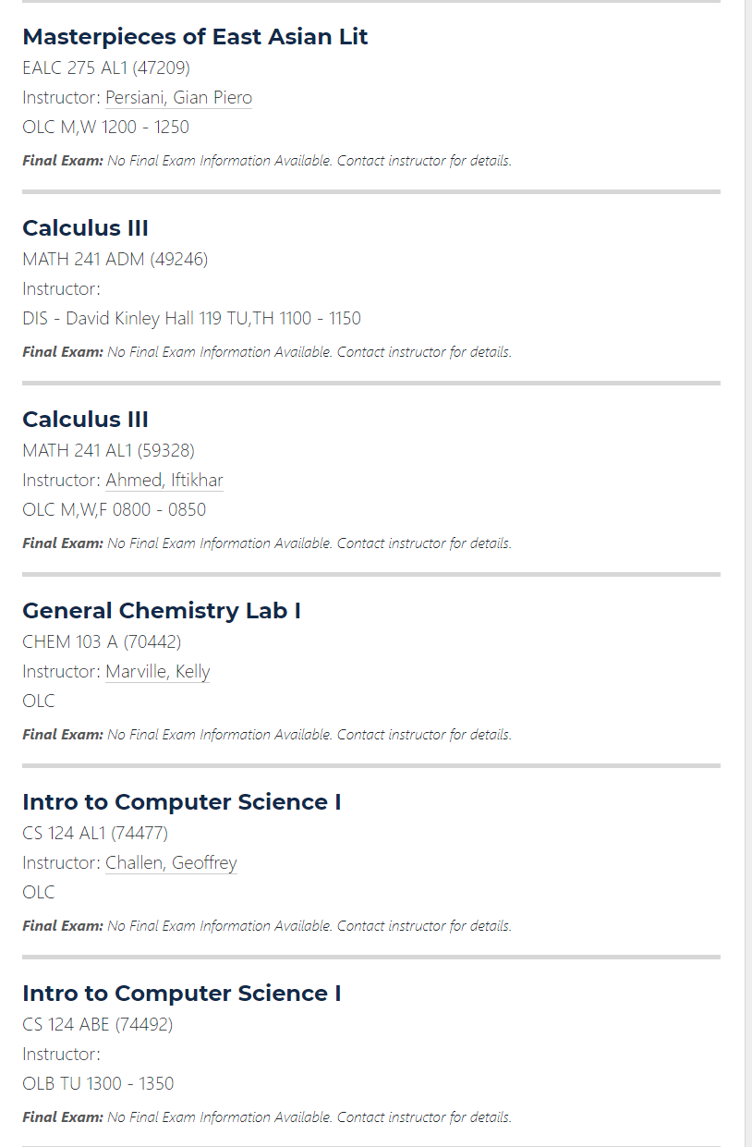

Slide 29
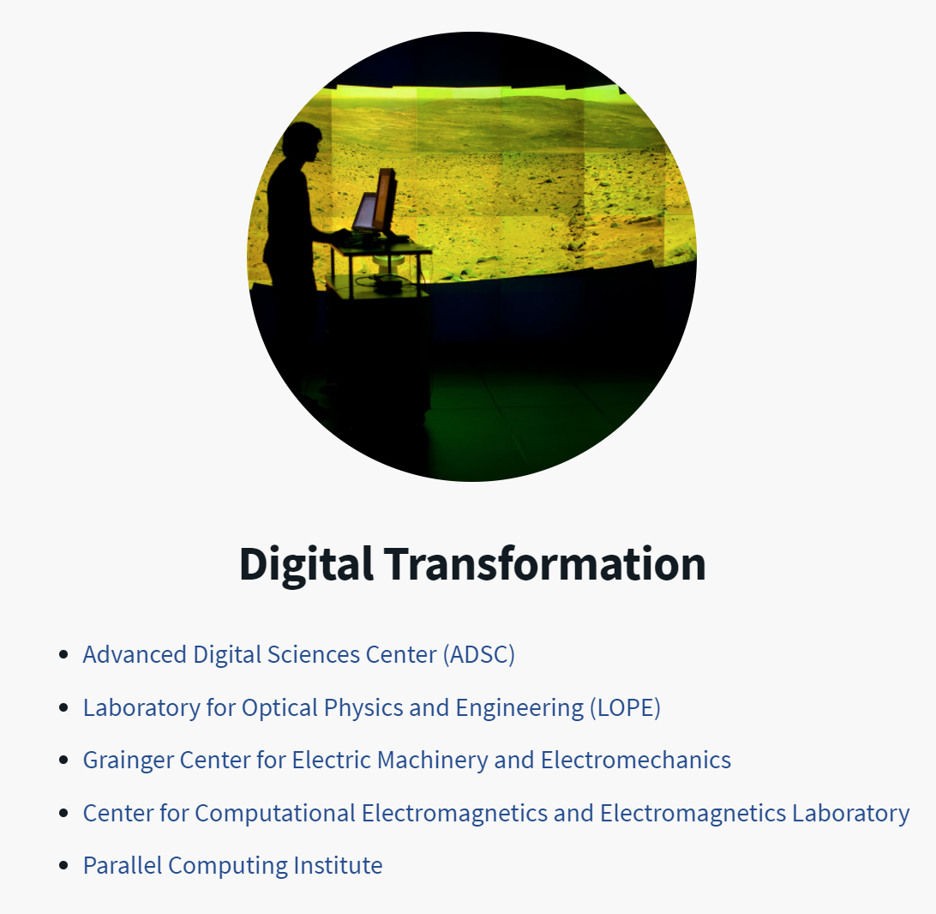



Slide 30
Internship

Slide 31


Slide 32
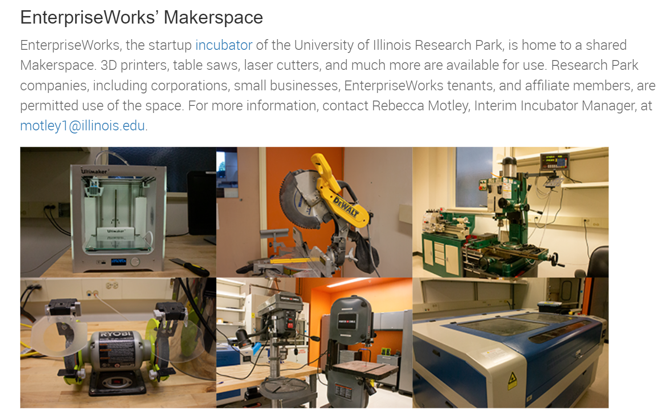

Slide 33
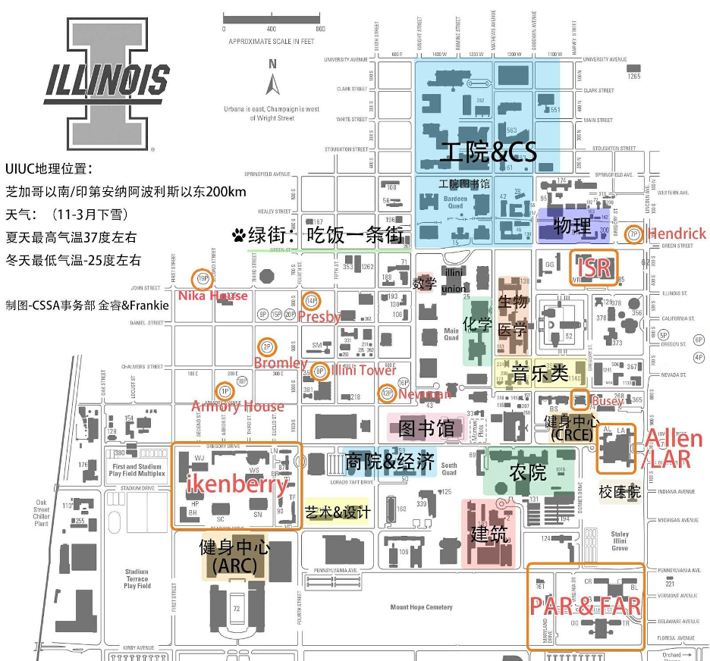

Slide 34
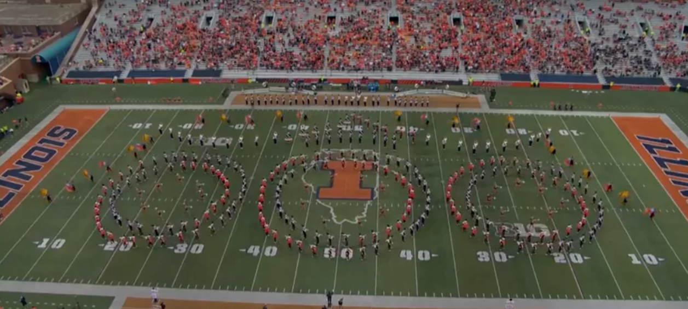
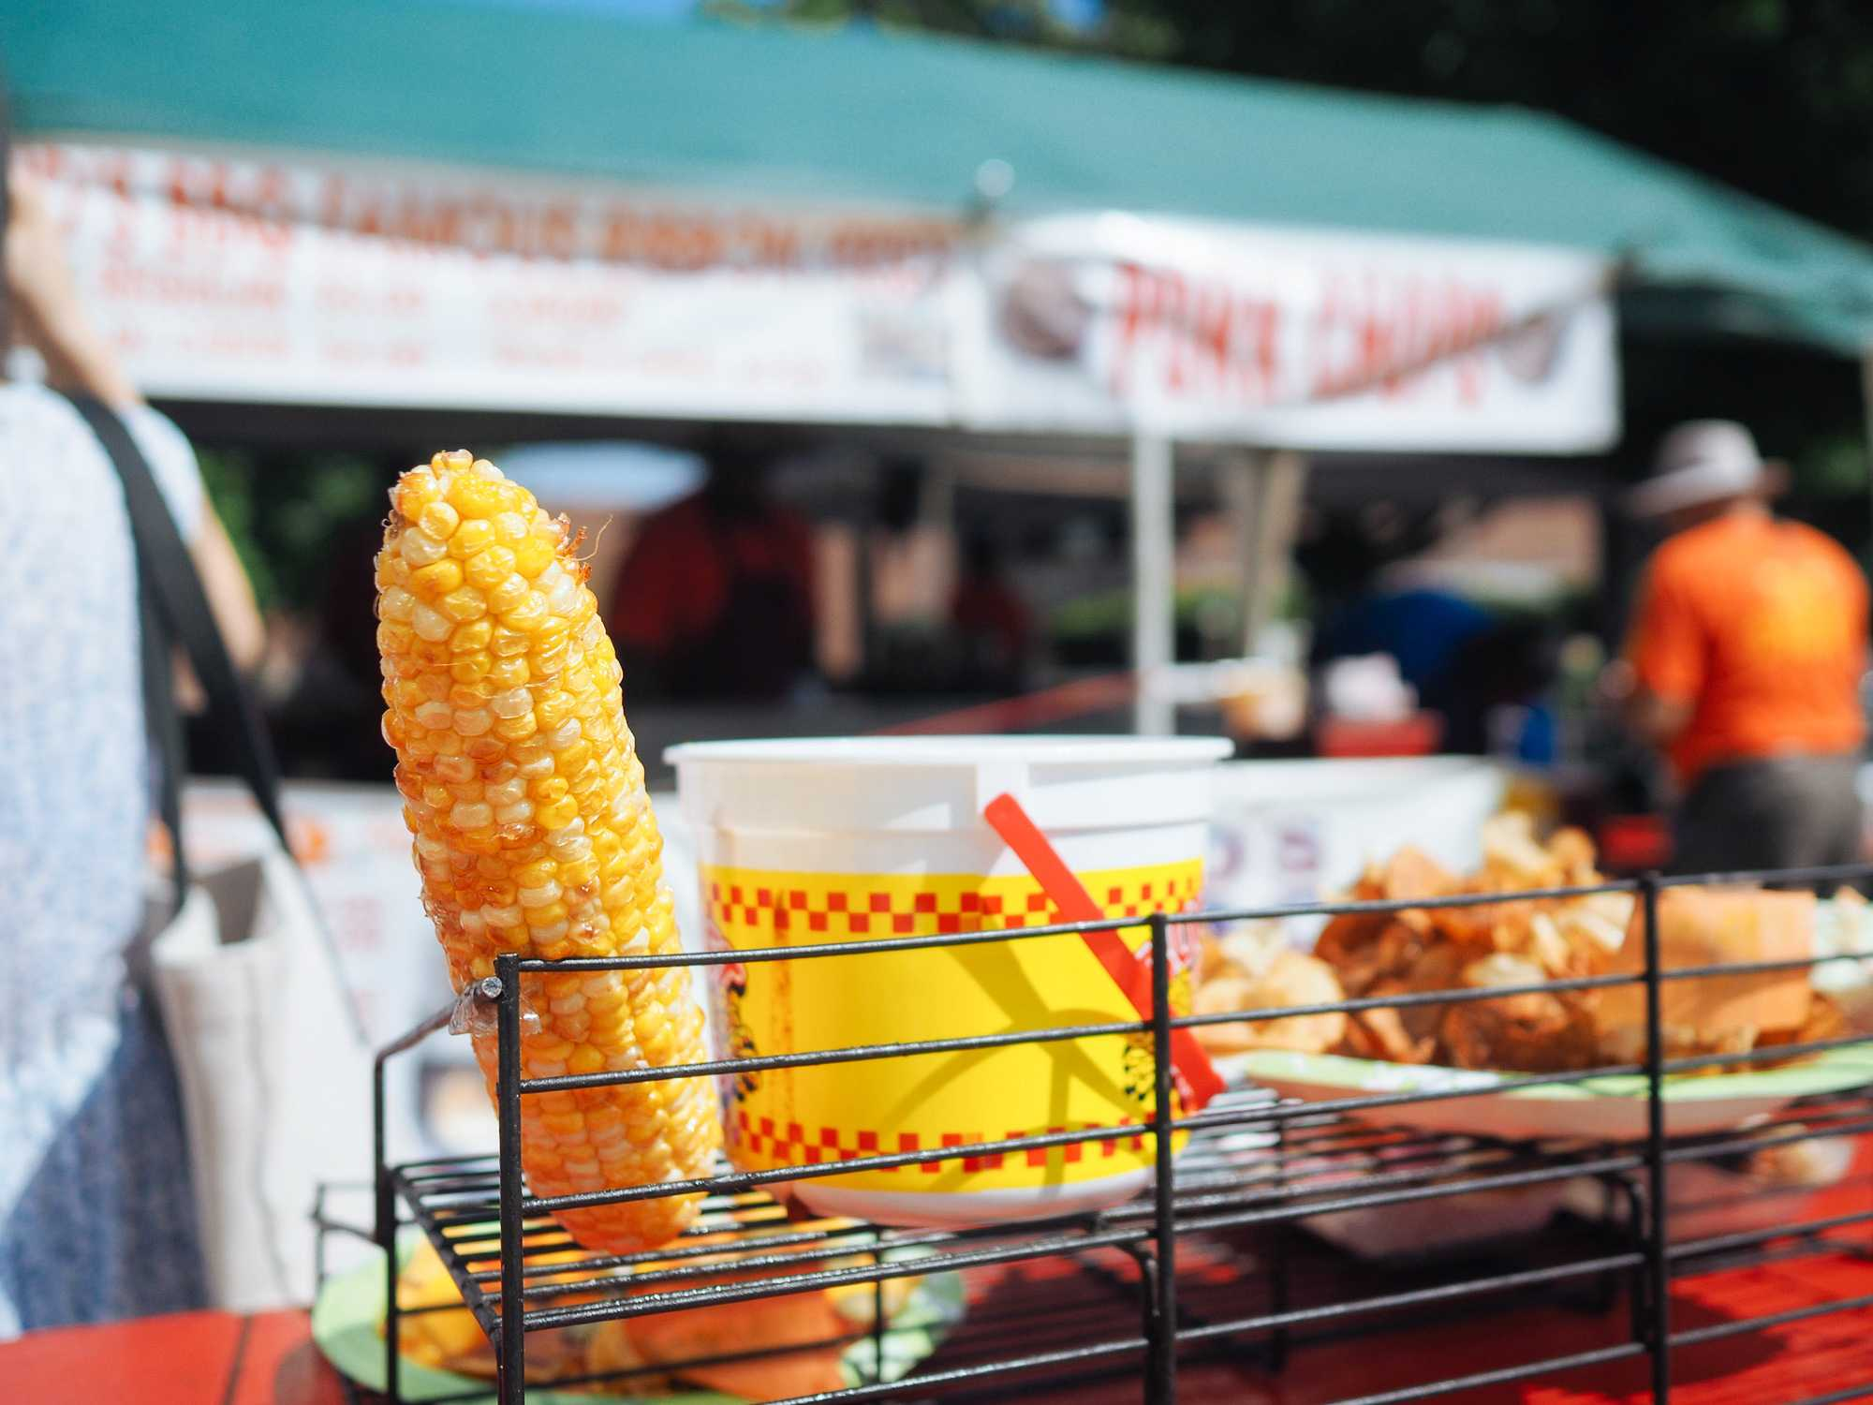

Slide 35
Thank You. EOF.

